Slide 1
LIBRARY BOOK RECOMMENDATION SYSTEM
One-line Idea:
“Find the right book faster and discover what to read next.”
Our Idea:
A smart library assistant that quickly searches books and recommends related titles using categories, authors, borrowing patterns, and relationships between books.
Problem Domain:
Library Management ,Smart Search ,Recommendation System
Team Members
Member 1 — G.HANSINI REDDY(25MVCSMR0034)
Member 2 — G.HASINI(25MVCSMR0038)
Member 3 — M.TRUPTIREKHA(25MVCSMR0085)
Member 4 — V.AISHWARYA(25MVCSMR0088)

Slide 2
THE CHALLENGE
The Real-World Problem:
Traditional library systems often help users find a specific book, but don't necessarily help them discover what to read next.
Problems Faced:
=> Slow Discovery
Users may spend time browsing large collections.
=> Information Overload
Thousands of books make selection difficult.
=> Limited Recommendations
Basic systems may not consider a user's borrowing behavior.
=> Hidden Relationships
Related books, authors and categories may not be obvious.
Why It Matters?
-The challenge isn't only finding a book — it's finding the RIGHT next book.

Slide 3
OUR INNOVATION
From Book Search → Smart Book Discovery
Our system combines multiple sources of information instead of relying only on keywords.
Core Idea:
Search + Relationships + Borrowing Patterns = Smart Recommendations
Key Features:
Fast Search - Find books efficiently.
Personalized Recommendations - Uses borrowing history and interests.
Book Relationship Graph - Connects related books.
Considers:
Category
Author
Borrowing patterns
Related books
Our Unique Approach
Graph algorithms + search algorithms + borrowing behaviour in one library assistant

Slide 4
HOW IT WORKS
Simple Workflow
USER
↓
Search / Select a Book
↓
Binary Search
↓
Book Information
↓
Analyze Category + Author + Borrowing History
↓
BFS / DFS
↓
Generate Related Books
↓
Sort by Relevance
↓
RECOMMENDATIONS
User Journey:
User searches :
Python Programming
↓
System identifies:
Category: Programming
Author: XYZ
Borrowing Pattern: Frequently borrowed with Data Science books
↓
Graph explores related books:
Python → Data Science → Machine Learning → AI
↓
Output:
Recommended Books

Slide 5
TECHNOLOGY & ALGORITHM
Layer | Technology
Frontend | React
Backend | Python + Flask
Database | SQLite
Algorithms | Binary Search, Sorting, BFS, DFS
Why These Algorithms?
Binary Search :Fast searching in sorted book data, O(log n)
Sorting :Organizes books and recommendation results
BFS :Finds closely connected/nearby books in the graph
DFS :Explores deeper relationships between books
Architecture :React UI → Flask API → Recommendation Engine → SQLite

Slide 6
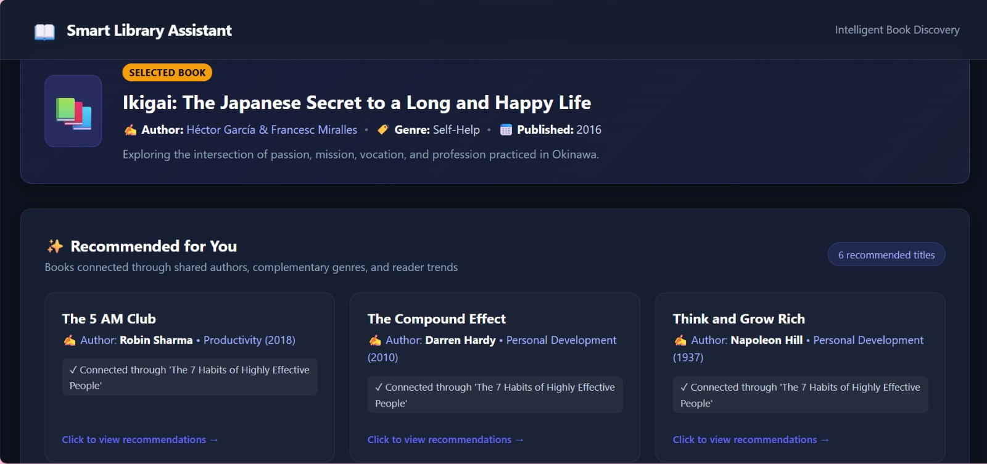
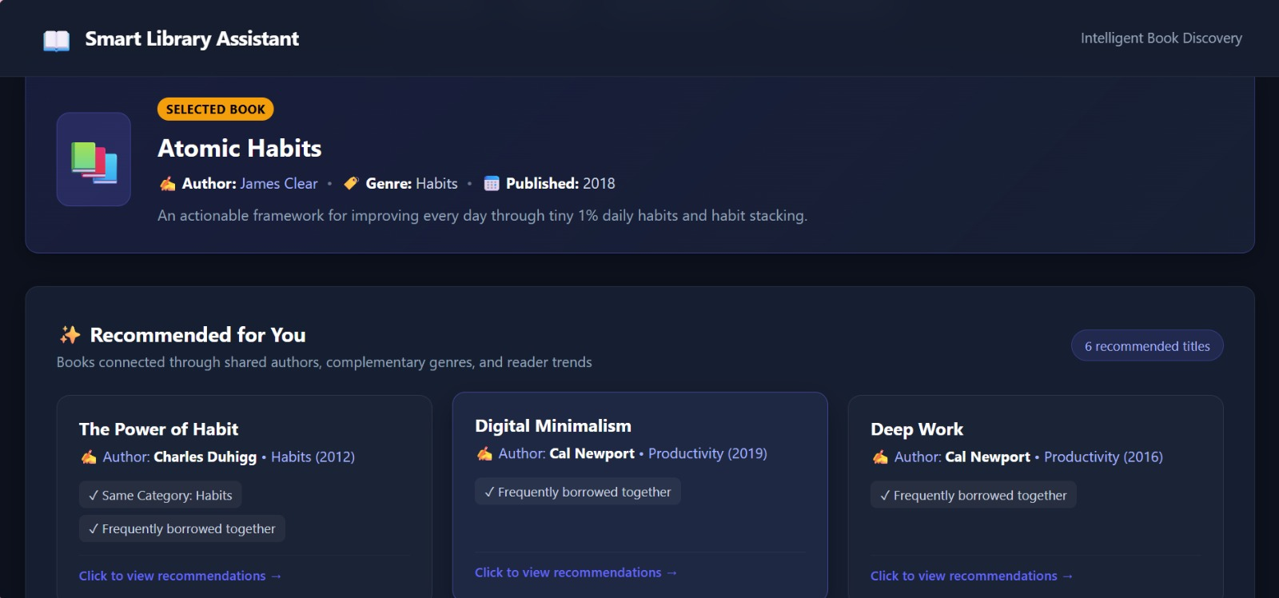
DEMO & IMPACT

Slide 7
FUTURE VISION
What We Achieved:
Fast book search
Algorithm-based recommendations
Book relationship graph
Borrowing-pattern analysis
Simple web-based architecture
Future Improvements
AI/ML Recommendations :Learn user preferences automatically.
Ratings & Reviews :Use user feedback to improve recommendations.
Voice Search :Search for books using natural language.
Mobile Application :Access recommendations anywhere.
Cloud Scalability :Support large libraries and multiple branches.
Final Takeaway:
“We are not just helping users find books — we are helping them discover their next book.”

Slide 8
THANK YOU

